Slide 1
Audio Classification
Colin Jemmott
DSC 96

Slide 2
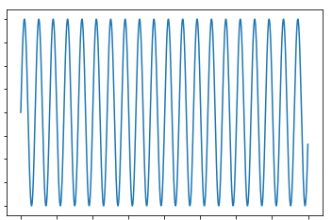
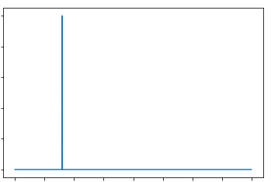
Audio processing
Time
Frequency

Slide 3
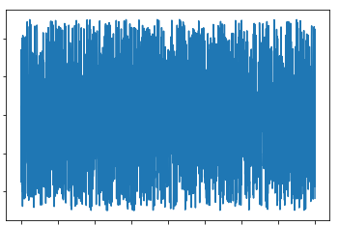
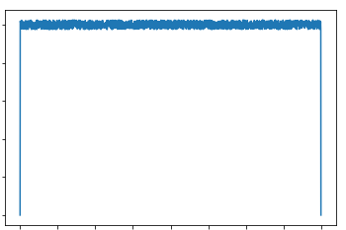
Audio processing
Time
Frequency

Slide 4
Digital Signal Processing
DSP is most strongly associated with linear transformations such as:
Filtering (changing the relative magnitude of different frequencies)
Reverberation (adding time delayed copies)
Other common DSP techniques for audio signals include:
Amplitude compression (making everything loud)
Lossy data compression (making files smaller and less accurate)
Manipulations to make speech more intelligible or music sound better

Slide 5
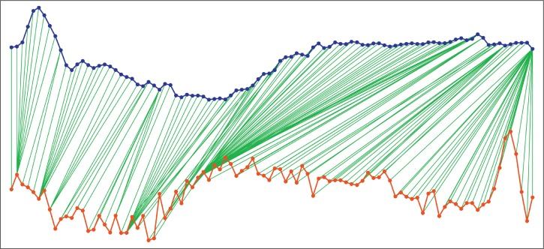
Speech Recognition History
1960s Dynamic Time Warping (frames). 200 words (with isolated words)

Slide 6
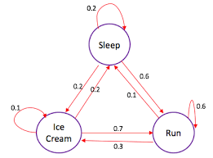
Speech Recognition History
1960s Dynamic Time Warping (frames). 200 words (with isolated words)
1970s Markov Chains to encode language and syntax. Continuous speech at one hour of processing per minute.

Slide 7
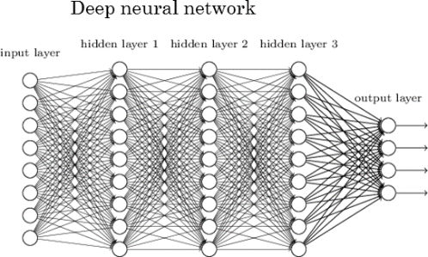
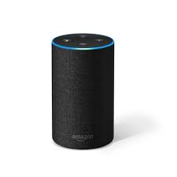
Speech Recognition History
1960s Dynamic Time Warping (frames). 200 words (with isolated words)
1970s Markov Chains to encode language and syntax. Continuous speech at one hour of processing per minute.
1980s n-grams and faster computers: 20,000 words, still not realtime.
1990s commercial success with limited vocabulary and special microprocessors
2000s labeled data gathering and the NSA. Poor accuracy prevented widespread use.
2010s Deep learning, Siri, Alexa, Cortana, Google.

Slide 8
Why is speech recognition so hard?
Large vocabulary (proper nouns and jargon)
Speaker variability (accents!)
Word confusability
Context-dependency
Noise / reverberation
Conversational versus human-machine speech

Slide 9
Assignment Today
Listen to a sound file
Read it into Python as an array
Add some noise, save, download and listen
Remove the long pauses from the speech (speaking recognition)
Use a pre-built audio classification API, and explore the effect of noise

